Slide 1
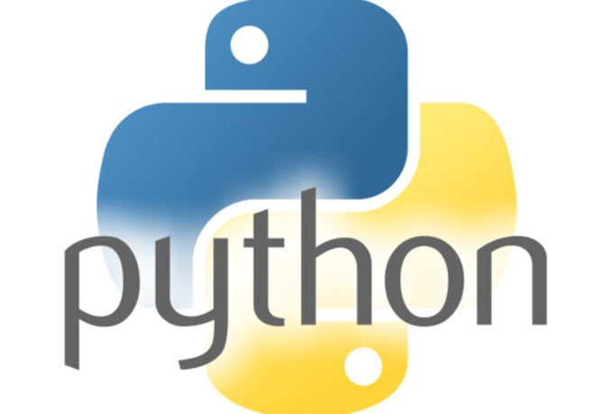

Slide 2
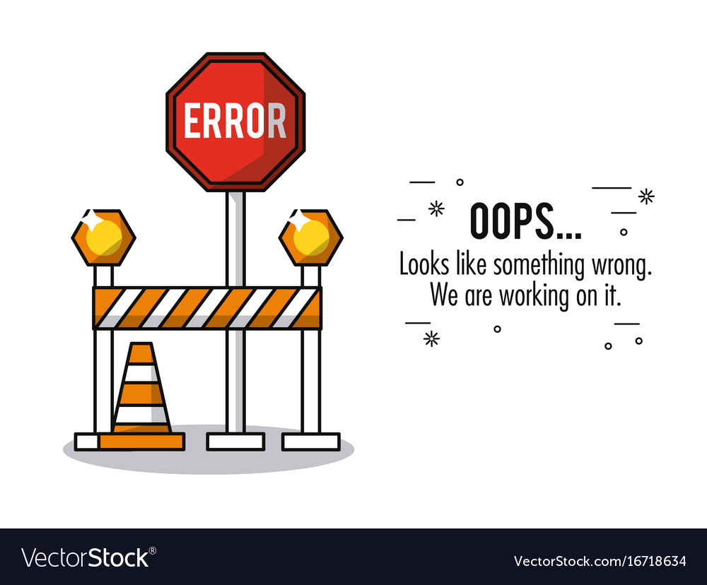

Slide 3
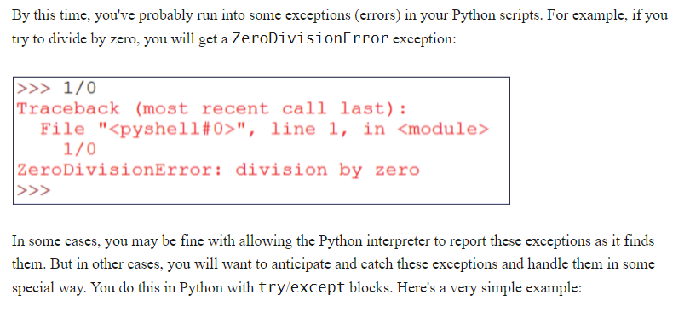
Exception Handling

Slide 4
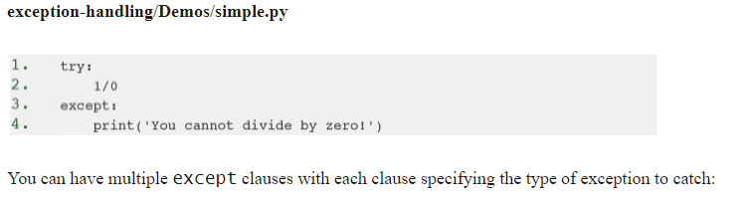
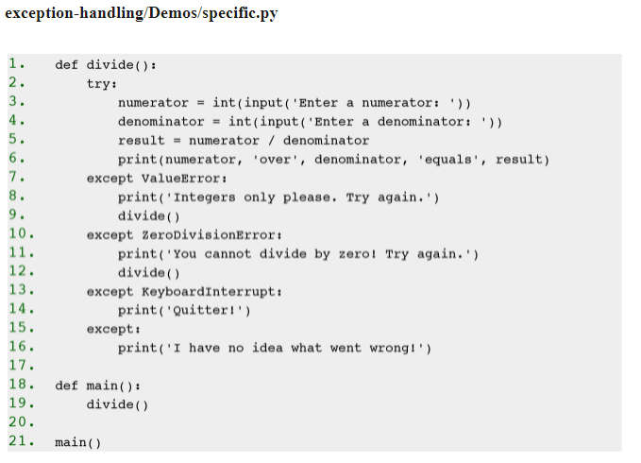
Notes:
If the user enters anything other than an integer for the numerator or denominator, the int() function will fail and a ValueError exception will be thrown.
•
If the user enters 0 for the denominator, a ZeroDivisionError exception will be thrown.
•
If the user quits the program by pressing CTRL+C, a KeyboardInterrupt exception will be thrown.
•
The last except clause, which is optional, serves as a wildcard to catch any unspecified exception types.

Slide 5
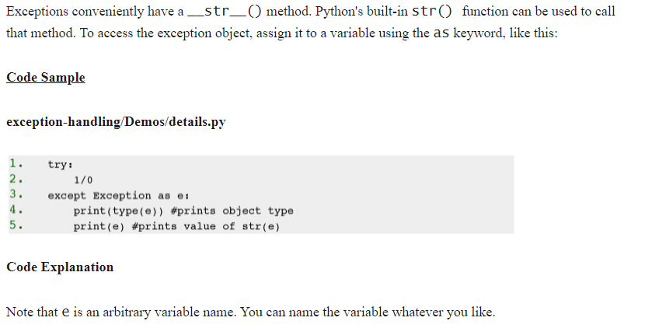
Exception Information

Slide 6
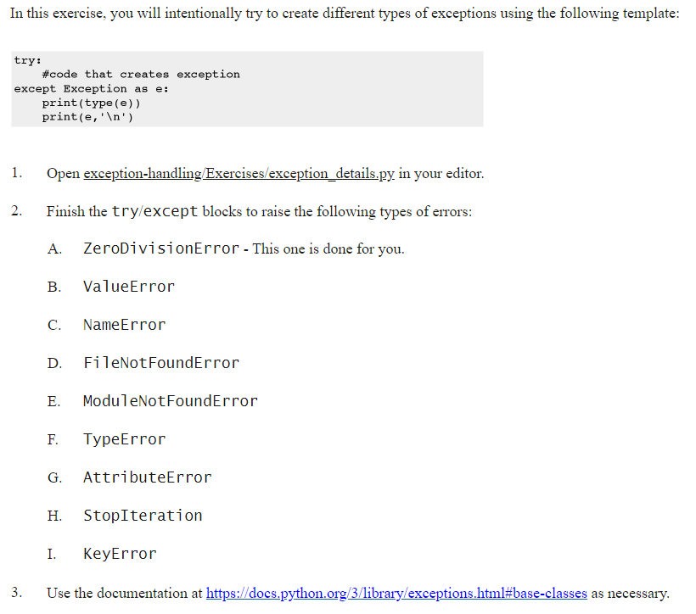

Slide 7
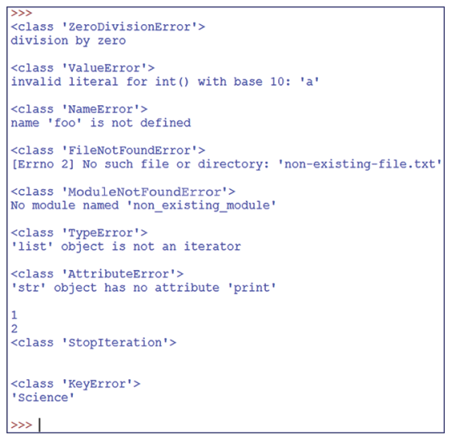
Exercise Output

Slide 8
Else Clause
We want to limit our try clause to the code that might cause an exception. After the final except clause, we can include an else clause that contains code that only runs if no exception was raised in the try clause. Take a look at the following example:

Slide 9
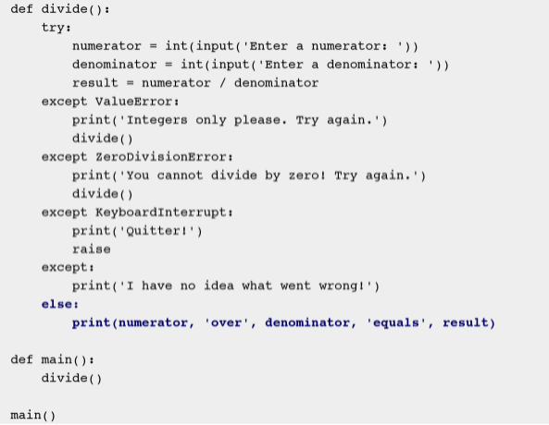

Slide 10
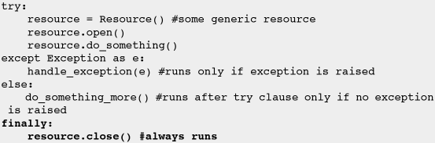
Finally Clause
The finally clause is for doing any necessary cleanup (e.g., closing connections, releasing resources, etc.). Here is a pseudo-example:

Slide 11
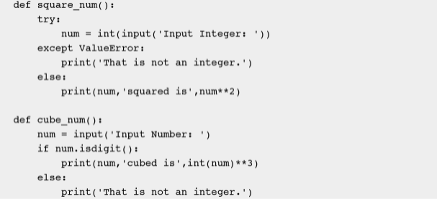
Flow Control with Exceptions

Slide 12
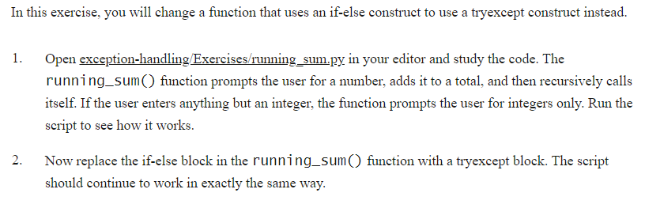
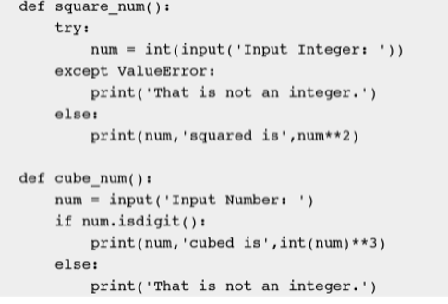
Exercise: Running Sum

Slide 13
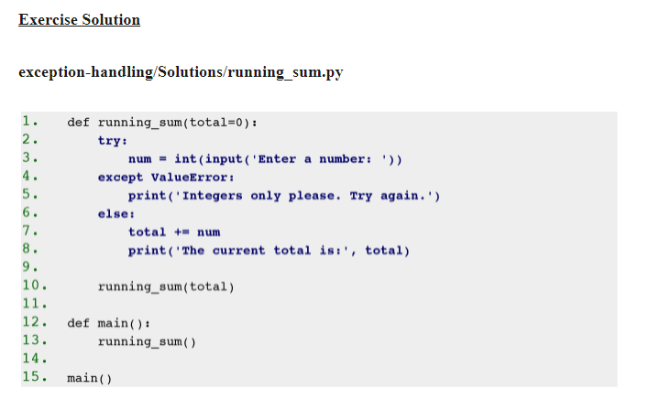

Slide 14


Slide 15
Date Time Functions
The epoch is the moment that a computer or computer language considers time to have started. Python considers the epoch to be January 1, 1970 at midnight (1970-01-01 00:00:00).Times before the epoch are expressed internally as negative numbers.

Slide 16
Clocks
time.clock() - deprecated in 3.3
time.monotonic() - new in 3.3
time.perf_counter() - new in 3.3
time.process_time() - new in 3.3
time.time()

Slide 17
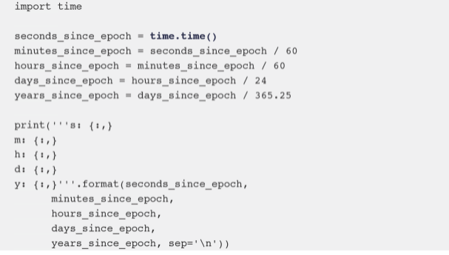
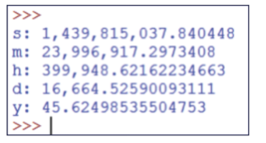
Absolute time: time.time()

Slide 18
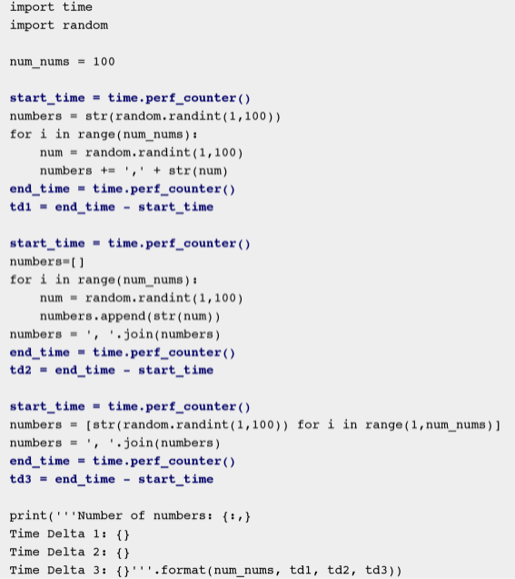
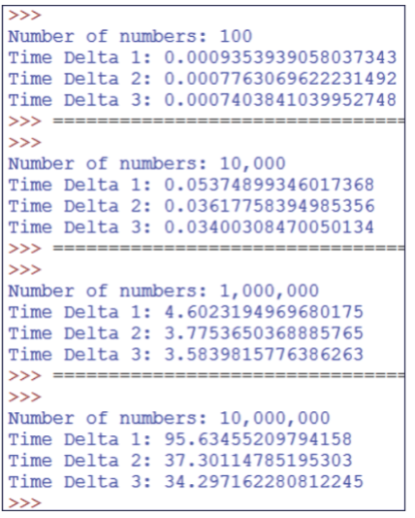
Relative time: time.perf_counter()

Slide 19
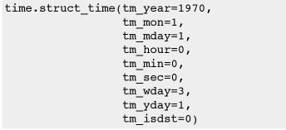
Time Structures
In addition to expressing time in seconds since the epoch as time.time() does, time can be expressed as a special time.struct_time object, which is a type of tuple. The time.struct_time object for the epoch looks like this:

Slide 20
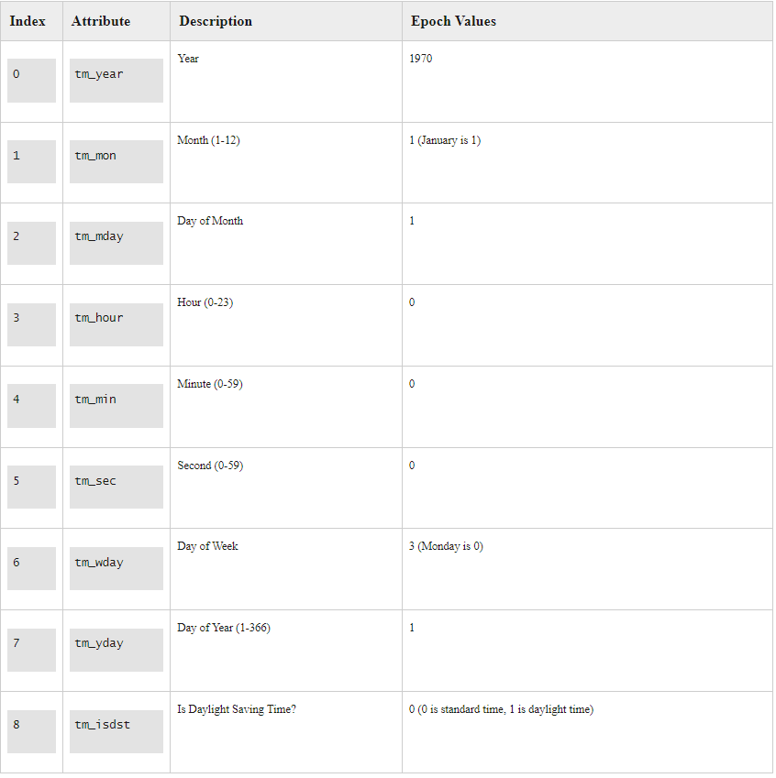

Slide 21

Converting to struct

Slide 22
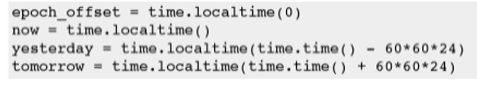
Exercise
Get the individual year, month, day from the structure
Make a struct with the same date from last year
Print the 4 dates like 15-06-2021, using the structure
Check names!

Slide 23
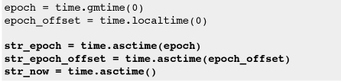
Converting to string: time.asctime()
Converts a time expressed as a struct_time to a date represented as a string. If the struct_time argument is omitted, it defaults to time.localtime(), which returns the current local time.

Slide 24
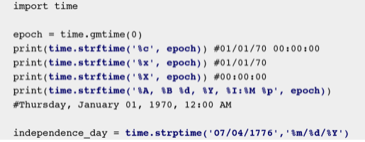
Time and formatted string
https://docs.python.org/3/library/time.html#time.strftime

Slide 25
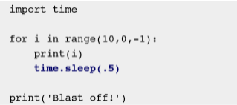
Waiting: time.sleep(secs)

Slide 26
Exercise
Maak een loop die seconden en tienden van seconde telt.
Output:
0.1
0.2
0.3
0.4
…
5.0
THE END

Slide 27
datetime module
datetime.date - a date with year, month, and day attributes.
datetime.time - a time with hour, minute, second, microsecond, and tzinfo attributes.
datetime.datetime - a combination of datetime.date and datetime.time.
datetime.timedelta - a duration expressing the difference between instances of two datetime.date, datetime.time, or datetime.datetime objects.

Slide 28
datetime.date objects
There are a number of datetime methods for creating datetime.date objects:
datetime.date(year, month, day)
date.today() - Returns the current local date.
date.fromtimestamp(timestamp) - Returns the local date corresponding to timestamp.

Slide 29
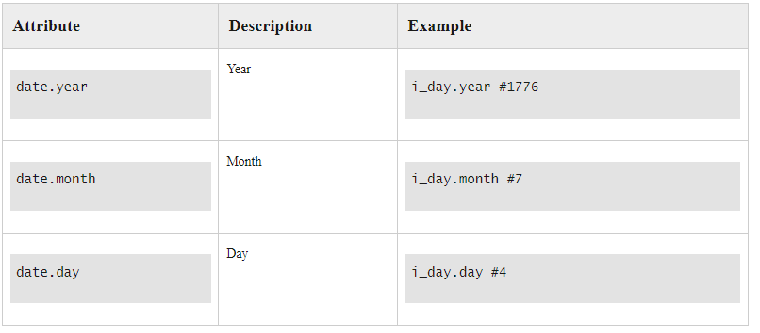
Attributes

Slide 30
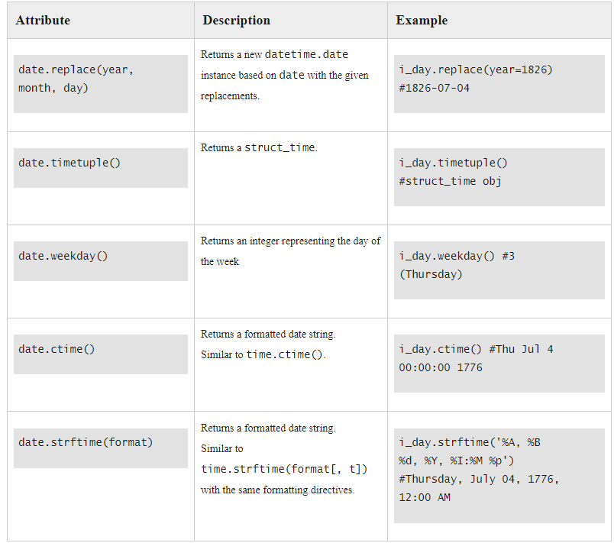
Methods

Slide 31

datetime.time objects
datetime.time objects are created with the datetime.time() method, which takes the following arguments:
hour - defaults to 0
minute - defaults to 0
second - defaults to 0
microsecond - defaults to 0
tzinfo - defaults to None.

Slide 32
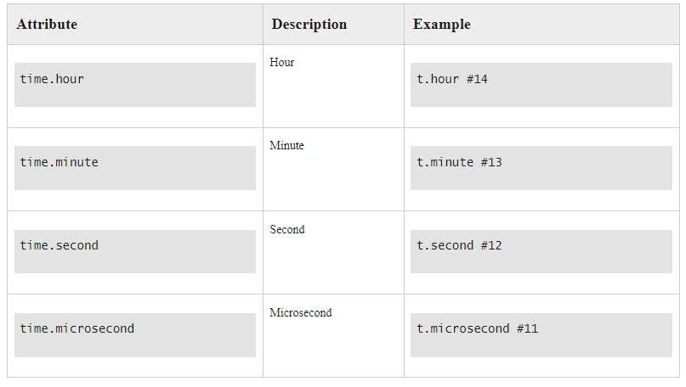
Attributes

Slide 33
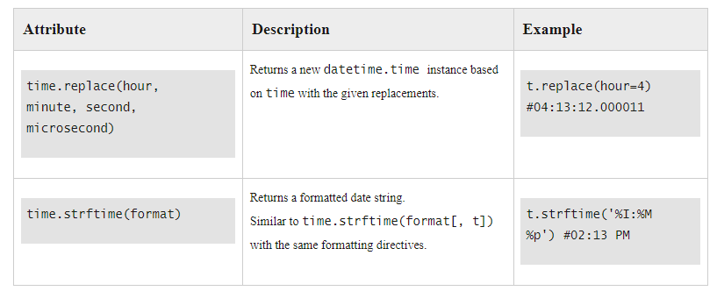
Methods

Slide 34
datetime.datetime objects
A datetime.datetime object is a combination of a datetime.date object and a datetime.time object. There are a number of datetime methods for creating datetime.datetime objects:
datetime(year, month, day, hour, minute, second, microsecond, tzinfo)
datetime.today() - Returns the current local date and time.
datetime.now() - like datetime.today() but allows for time zone to be set.
datetime.utcnow() - Returns the current UTC date and time.

Slide 35
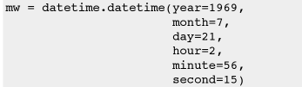
datetime.datetime object
Continued…
datetime.fromtimestamp(timestamp) - Returns the local date and time corresponding to timestamp.
datetime.utcfromtimestamp(timestamp) - Returns the UTC date and time corresponding to timestamp.
datetime.combine(datetime.date, datetime.time) - Combines a datetime.date object and datetime.time object into a single datetime.datetime object.
datetime.strptime(date_string, format) - Like time.strptime(string[, format]) with the same formatting directives.

Slide 36
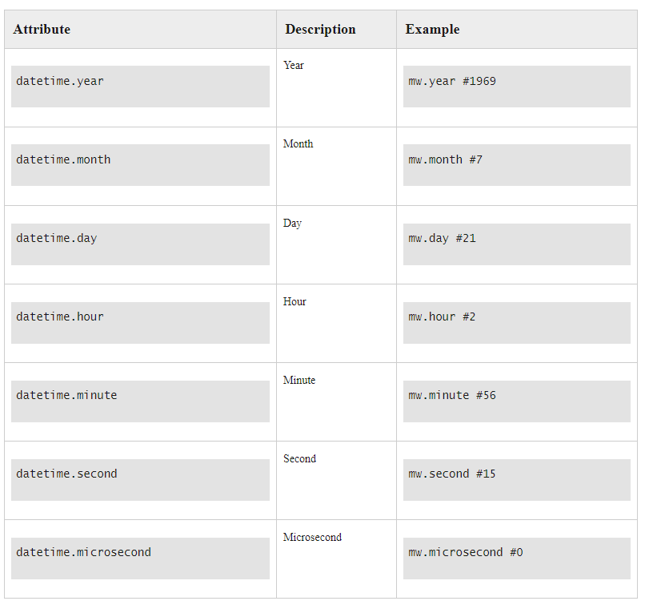
Attributes

Slide 37
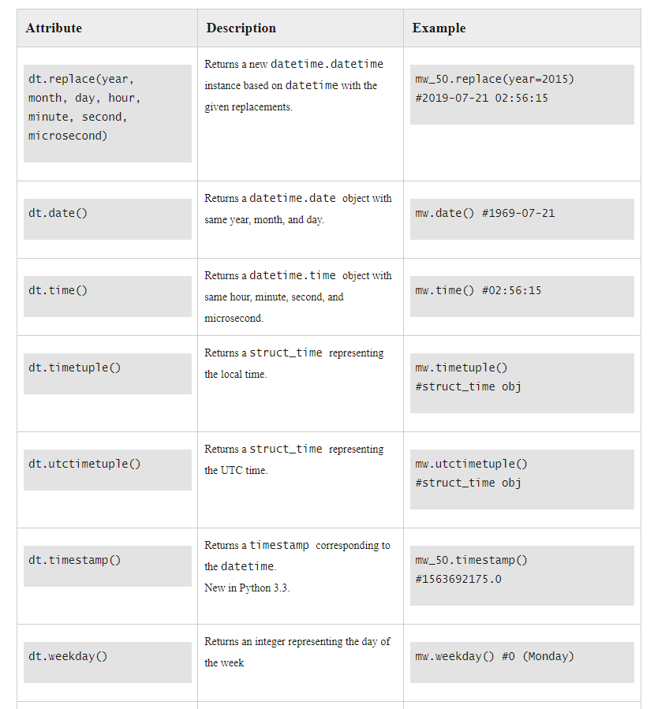
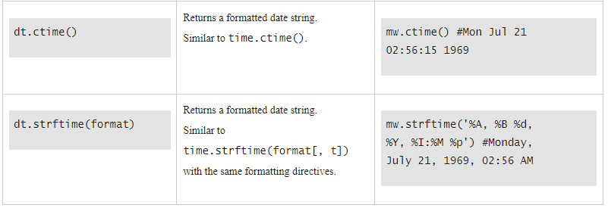
Methods

Slide 38

Datetime.timedelta object
datetime.timedelta objects can be:
Added (t1 + t2). Result: a new datetime.timedelta object.
Subtracted (t1 - t2). Result: a new datetime.timedelta object.
Divided (t1 / t2). Result: a float.
Multiplied by an integer or float (t1 * 2). Result: a new datetime.timedelta object.
Divided by an integer or float (t1 / 2). Result: a new datetime.timedelta object.

Slide 39
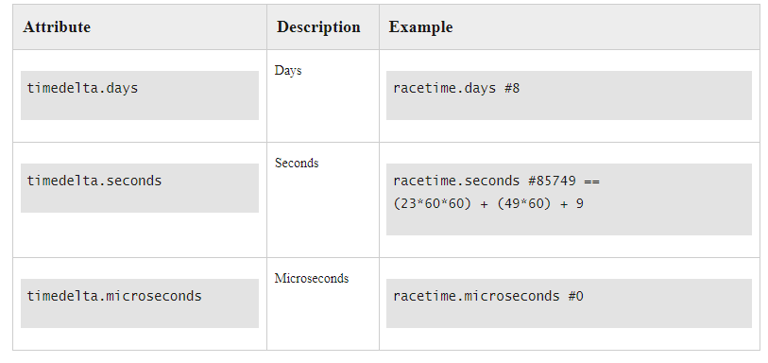
Atrributes

Slide 40
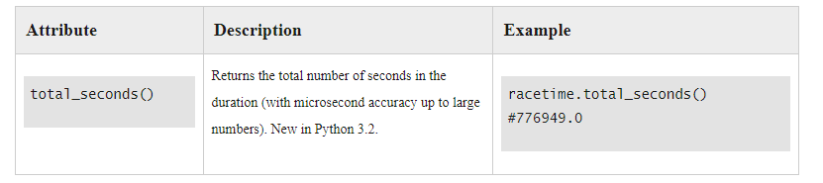
Methods

Slide 41
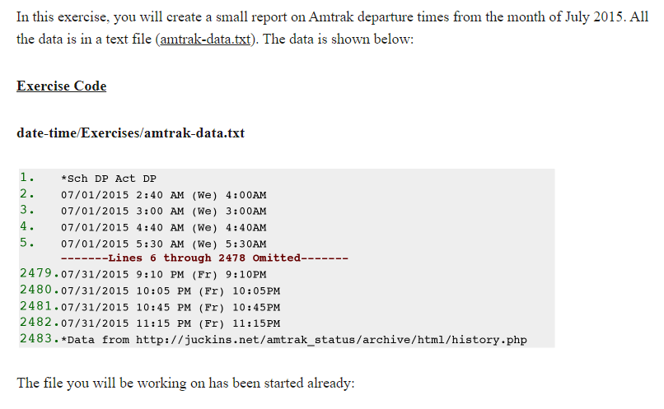
Exercise

Slide 42
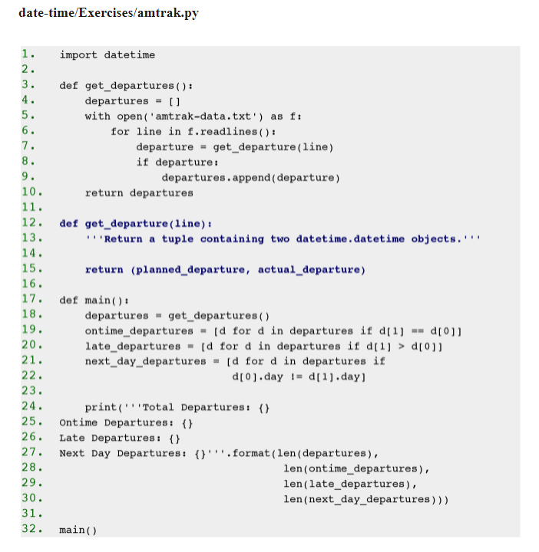

Slide 43
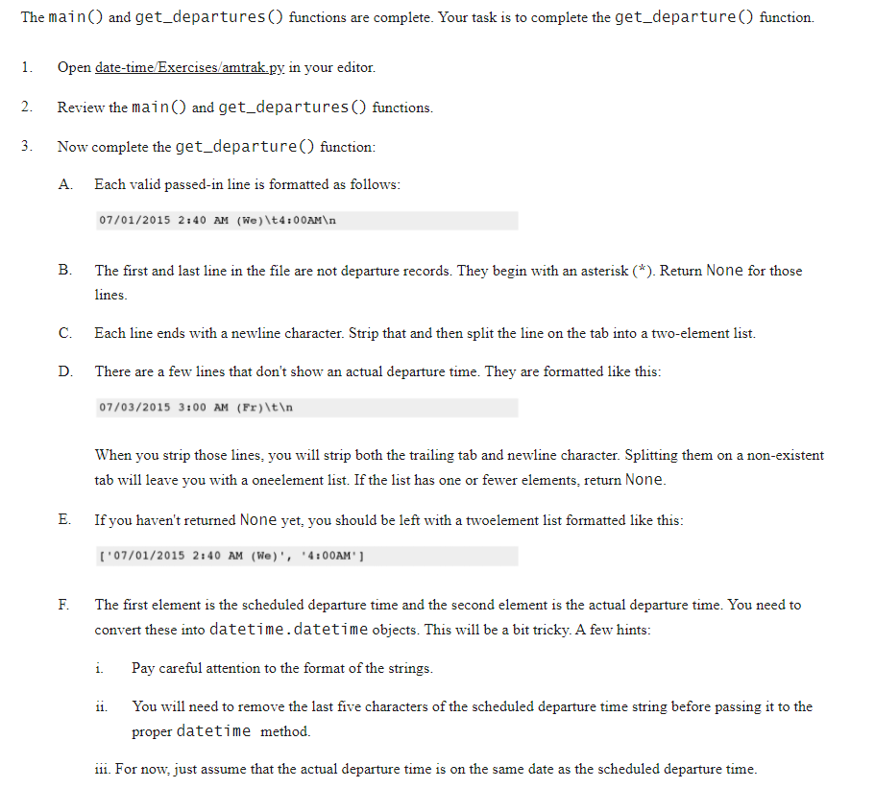

Slide 44
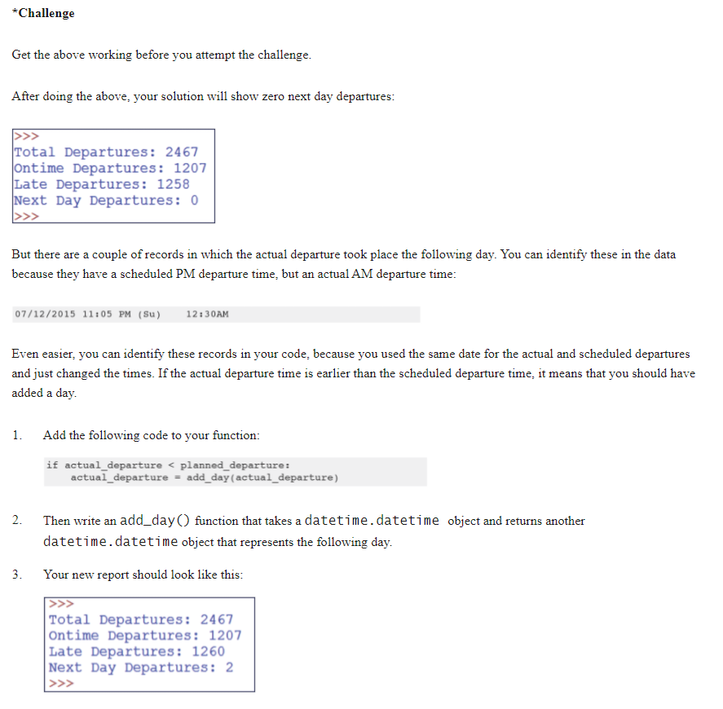

Slide 45
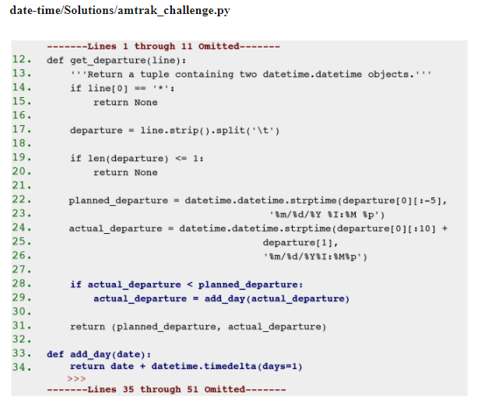
Challenge Solution

Slide 46
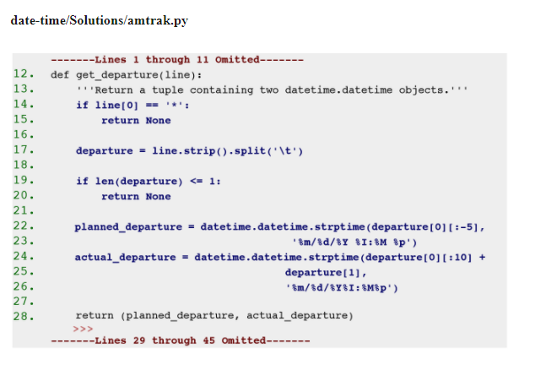
Solution

Slide 47
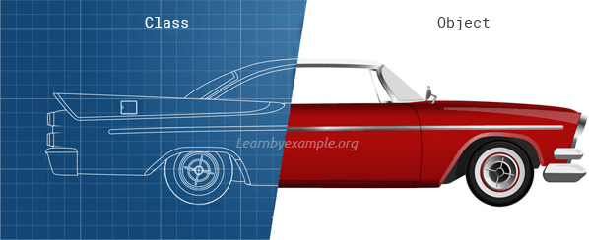
Object Oriented Programming

Slide 48
Classes - OOP
Object Oriented Programming
Benefits:
Reusability
Code Maintenance
Easier Troubleshooting
Flexibility

Slide 49
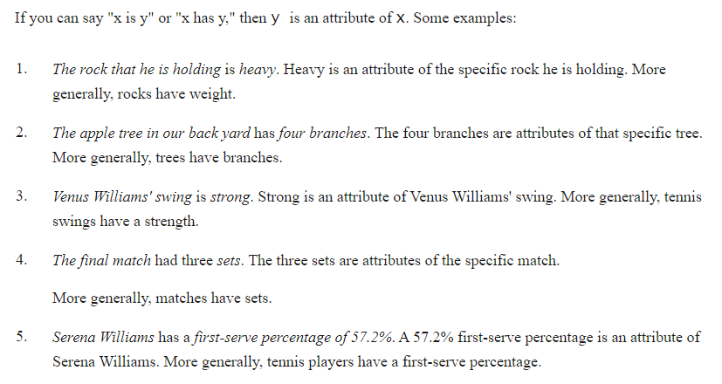
Attributes

Slide 50
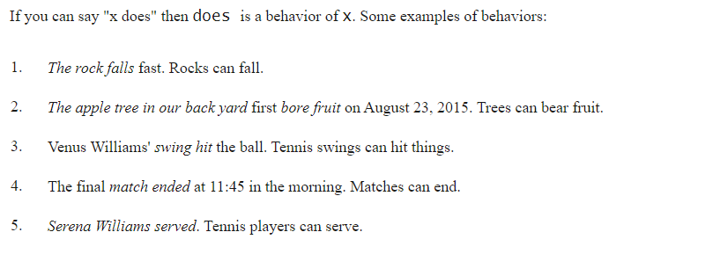
Behaviors

Slide 51
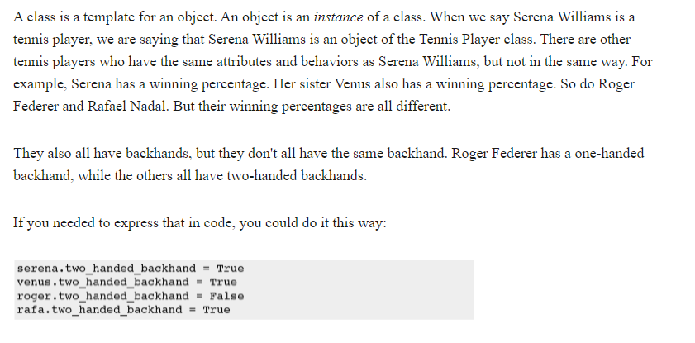
Classes vs Objects

Slide 52
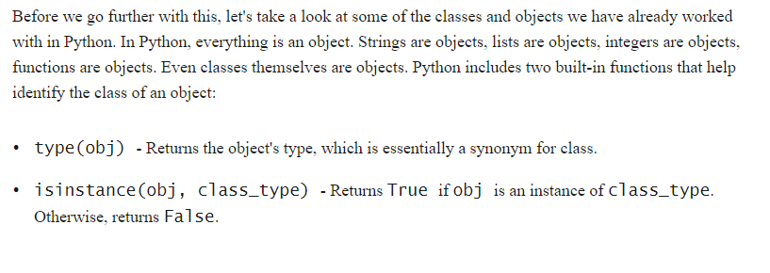
Everything is an Object

Slide 53
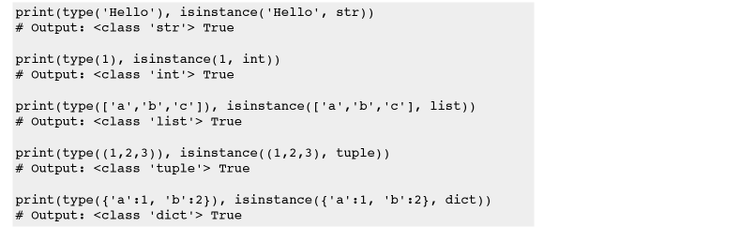
Everything is an Object II

Slide 54
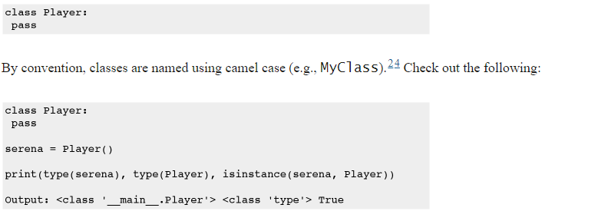
Creating Custom Classes

Slide 55
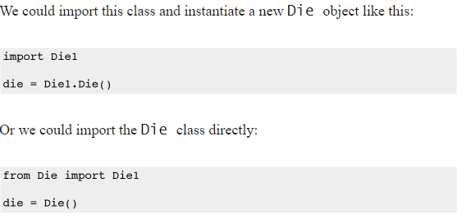
Die Class

Slide 56
Attributes and Methods
Every function always gets the ‘self’ parameter
Sides = 6 means the default value will be 6
__init__ is a special function used to initialize the object

Slide 57
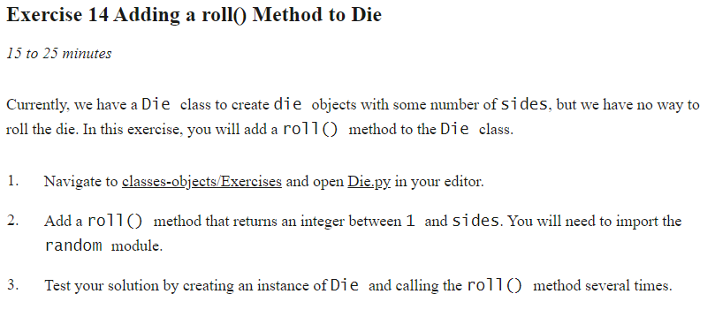
Exercise: Add a Roll method to the Die

Slide 58
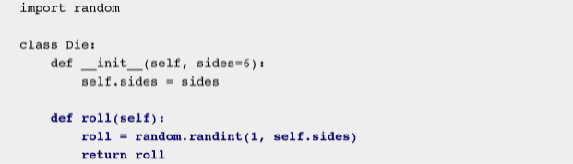
Custom methods

Slide 59

Exercise: Challenge
The Counter collection generates a Dictionary of all value and how often they occur.
from collections import Counter

Slide 60

Calling the roll method

Slide 61

Attributes
By using self.attributename you can add an attribute to a class
For instance

Slide 62
Encapsulation (private attributes)
The convention is using an underscore in front of the name
For instance _radius, _name, etc
This doesn’t actually prevent people from calling it in Python, unlike in languages like C#, Java, etc
Make getters and setters for variables to change the values if needed

Slide 63


Encapsulation (private attributes)

Slide 64

Properties
Using get_ and set_ methods can be annoying
Luckily there is another way

Slide 65


Properties 2
We can use the property keyword

Slide 66


Exercise: Properties

Slide 67

Solution

Slide 68

Inheritance Concept
Name
Weight
MakeNoise()
Name
Weight
Breed
MakeNoise()
Walk()
Bark()

Slide 69

Inheritance

Slide 70

Example

Slide 71


Exercise: Weighted Die

Slide 72

Extending a class method

Slide 73

Exercise: Extending the Roll Method

Slide 74

Solution

Slide 75


Class methods and Attributes

